Slide 1
TOVECO SHOP DESCRIPTION
All Toveco jewelry pieces start at the lapidary (gemstone cutting) stage. That being the case I have two separate shop locations, one in which I do the metal work and one in which do the lapidary work. That doesn’t mean that lapidary or metal work tasks are only done in the lapidary or metal shops. But main lapidary and metal tasks do required dedicated equipment which I have consolidated in the different shop locations.
The lapidary work starts by processing the gem rough into, preformed shapes and then sorted. The cutting gets done at the lapidary shop located in the Toveco Storefront. When I am cutting the gemstone is also when I start thinking about how the stone will be mounted. At times the stone mounting and jewelry design can be easily worked out other times the gemstone can sit around for years.
The jewelry metal work stage is performed at the metal shop. The jewelry is separated by the metal, Silver or Gold, and function, custom (one of a kind) and standard, everyday items. All the jewelry findings design work is done using Solidworks and proof of concept using a 3d printer. At this time 90% of rings and pendant findings and 50% of earrings findings are casted. The rest of the jewelry findings are fabricated using preformed findings (parts).
Now let’s check out the Shops.

Slide 2
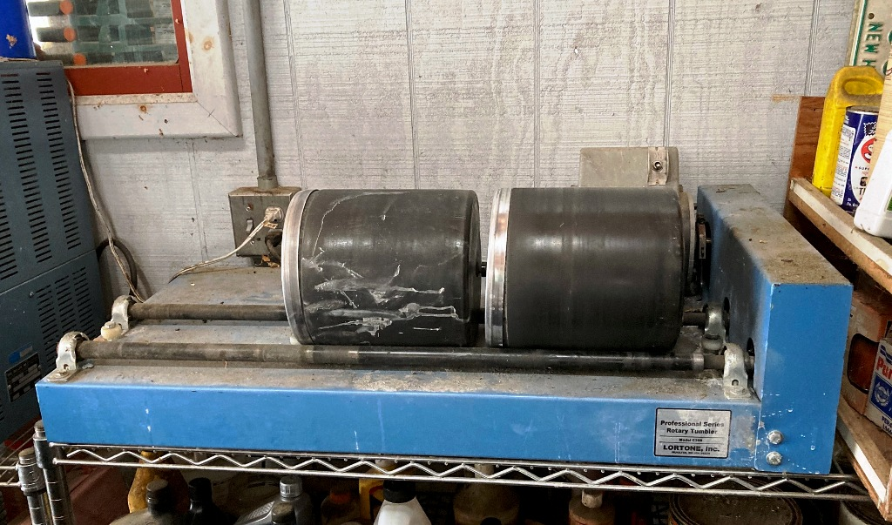
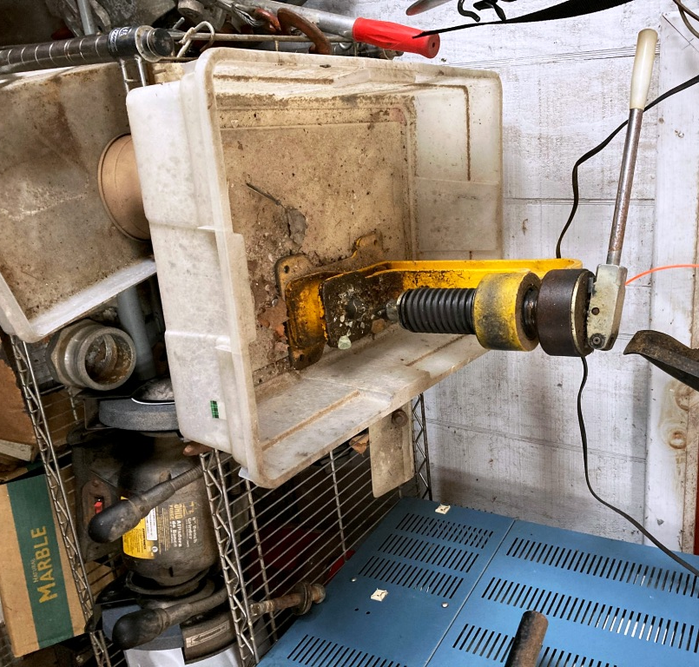
3 BARREL TUMBLER
HYDRAULIC ROCK TRIMMER
Lapidary Rough Prepping.
These tools are located in the barn, they are messy and the tumblers are loud.
The gem rough is trimmed and sorted. The rough that isn’t clear enough to cut a gemstone from gets tumbled and then re-sorted into cab, bead, chips or free-form tumbled shapes.

Slide 3
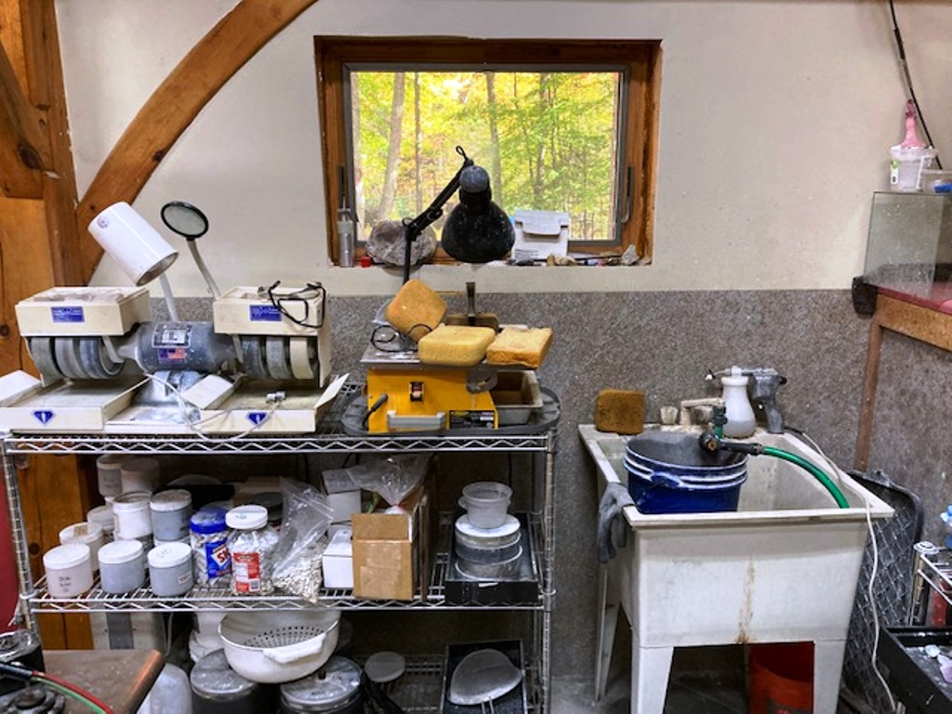
CABACHON MACHINE
TRIM SAW
TUMBLE GRIT AND
BARRELS
Home metal shop.
The gem rough are profiled (cut into general shapes) and sorted.
The tumble barrels and rough are set-up and cleaned here.

Slide 4
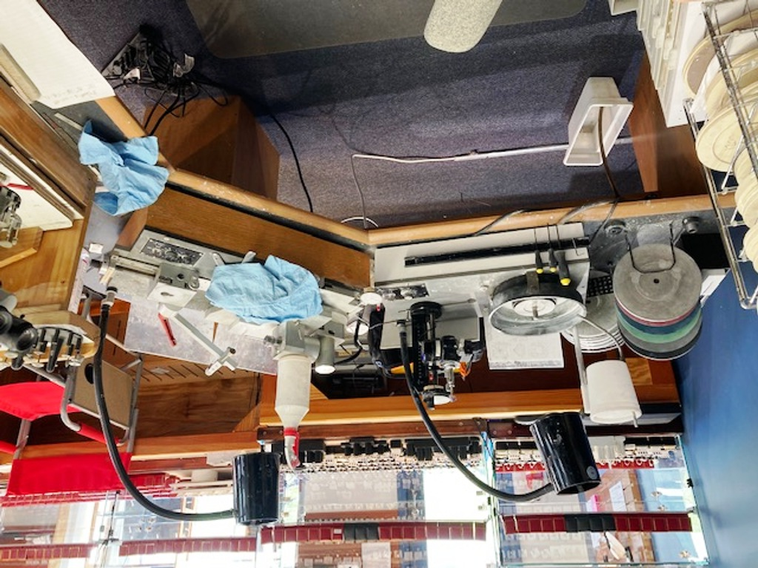
FLAT FACETING MACHINE
TRIM SAW
CONCAVE FANTASY MACHINE
STOREFRONT SHOP
These machines are the work horses for cutting all the Toveco gemstones.
I’m a concave fantasy cutter the flat faceting machine is used mostly to rough out the gemstone designs & finishing the gemstone tables. The gemstones final design and finish work is done on the Concave Fantasy machine.

Slide 5
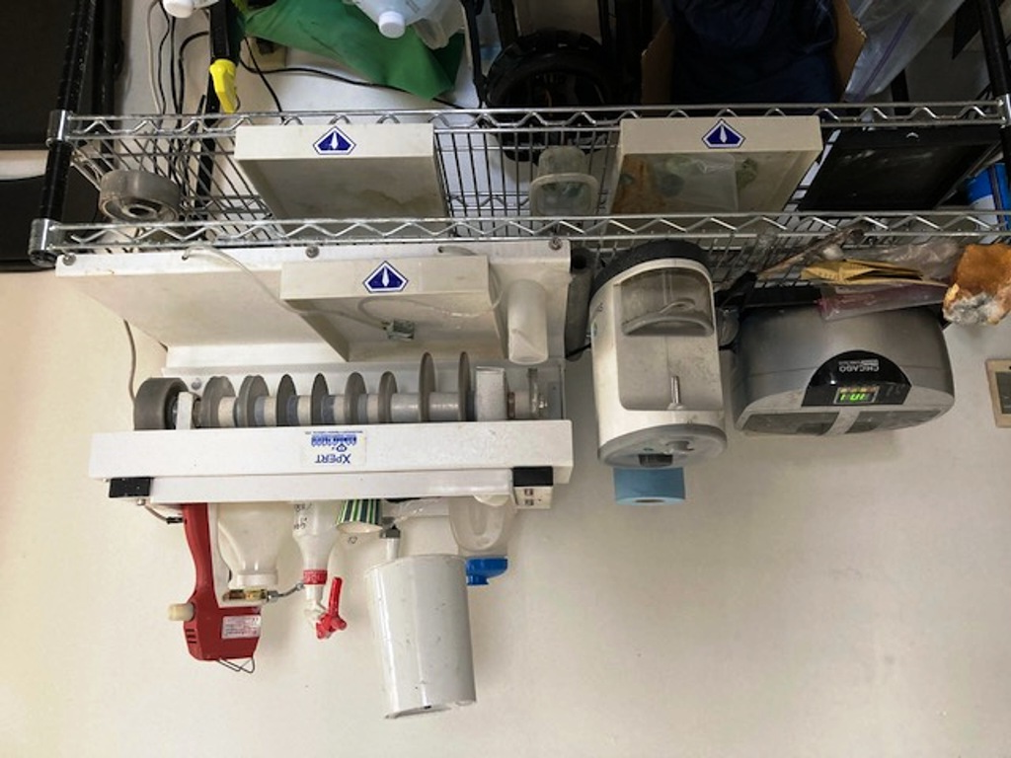
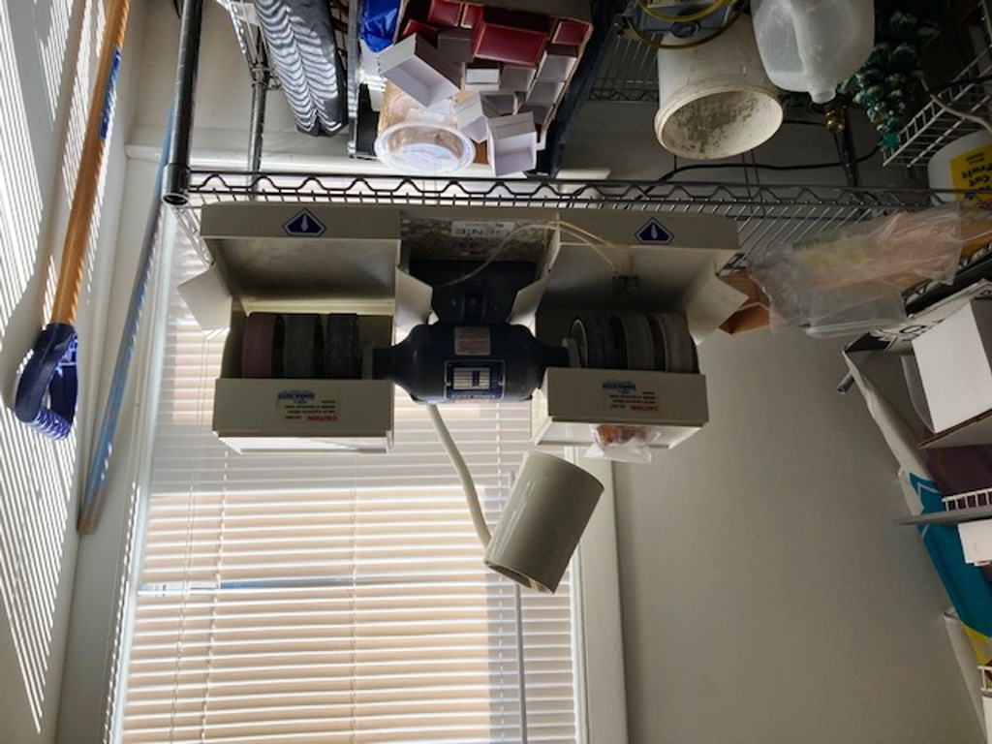
PROFILE CABOCHON MACHINE
ULTRASONIC CLEANER
AND STEAM CLEANER
CABACHON MACHINE
STOREFRONT SHOP
These machines are used for standard and fantasy cabochons and gemstone carvings.
I also use them for non-standard shaping gemstone profiling.

Slide 6
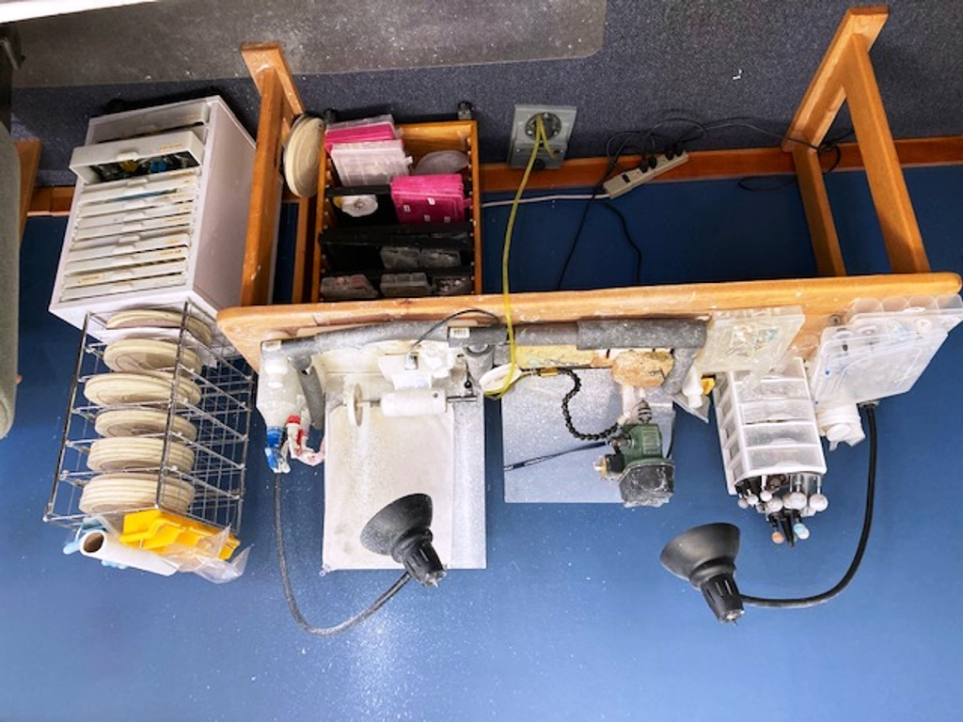
DRILL PRESS
FOREDOM ROCK LATHE
CARVING AND FANTASY TOOLING
STOREFRONT SHOP
I use these tools for stone & gemstone carving and fantasy work, like depressions, slicing, scalloping, scoping and polishing.

Slide 7
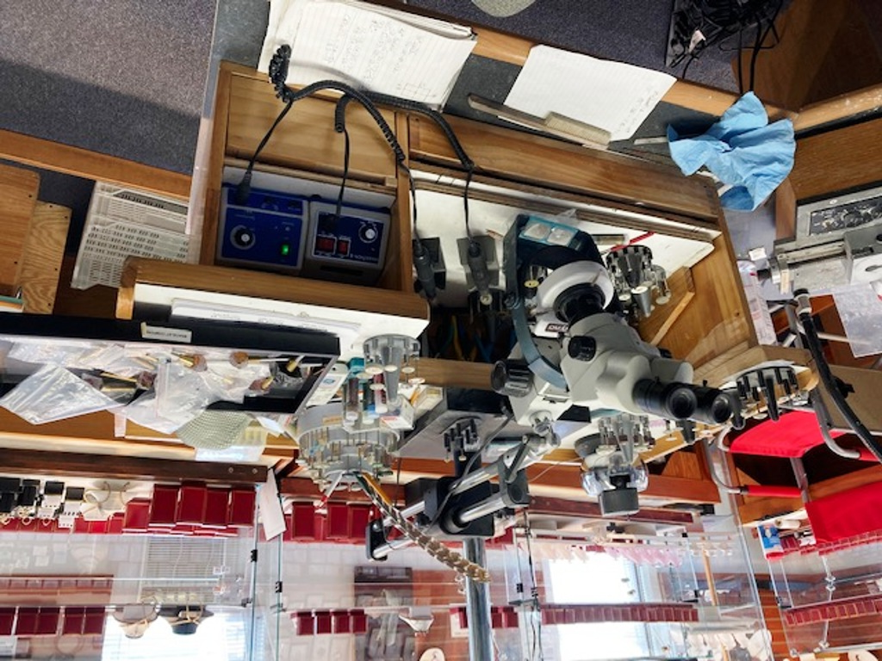
Stereo Zoom microscope
Polishing and carving tools
Micromotor & handpiece
STOREFRONT SHOP
These tools are where I do fine gemstone carving and polishing. I use the microscope so much it’s become a second set of eyes.

Slide 8
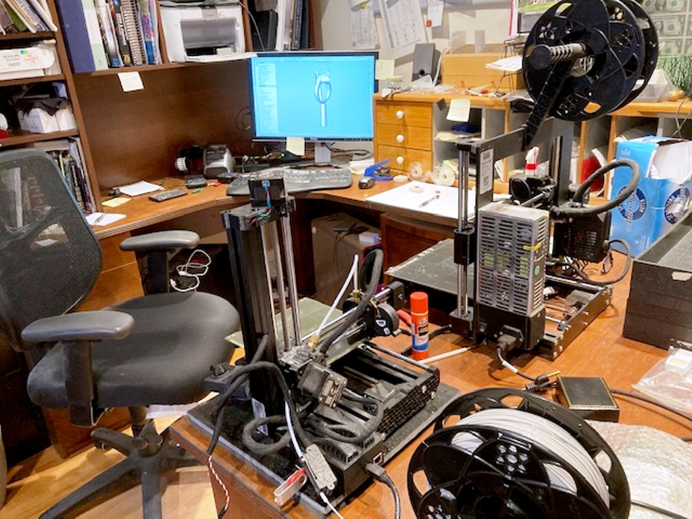
Solidworks parametric cad program
3D PRINTERS
Gemstone Mounting Design
All design work is preformed using Solidworks (parametric cad program). When the design is progressing I start 3d printing it out as a proof of concept. When the design is completed I then print out the final model and use it for lost wax casting.

Slide 9
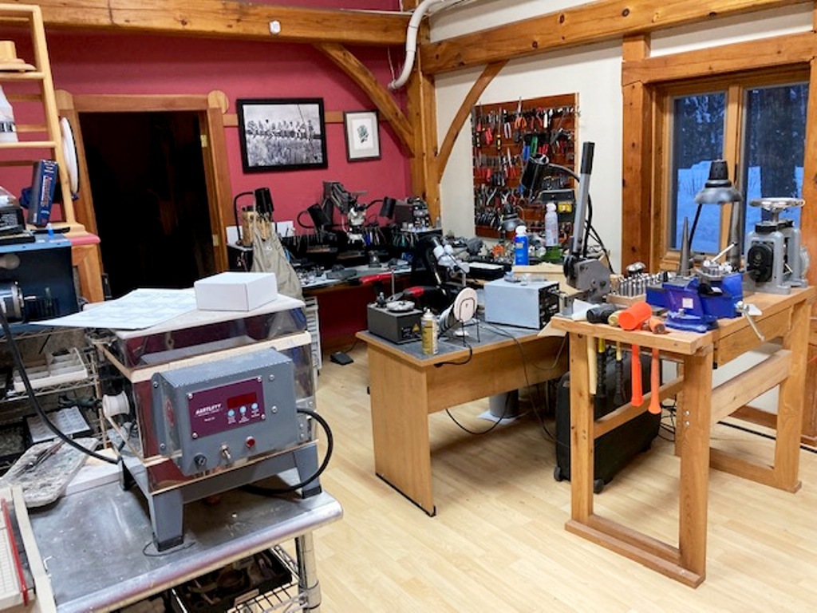
Home metal shop.
Right side overall view

Slide 10
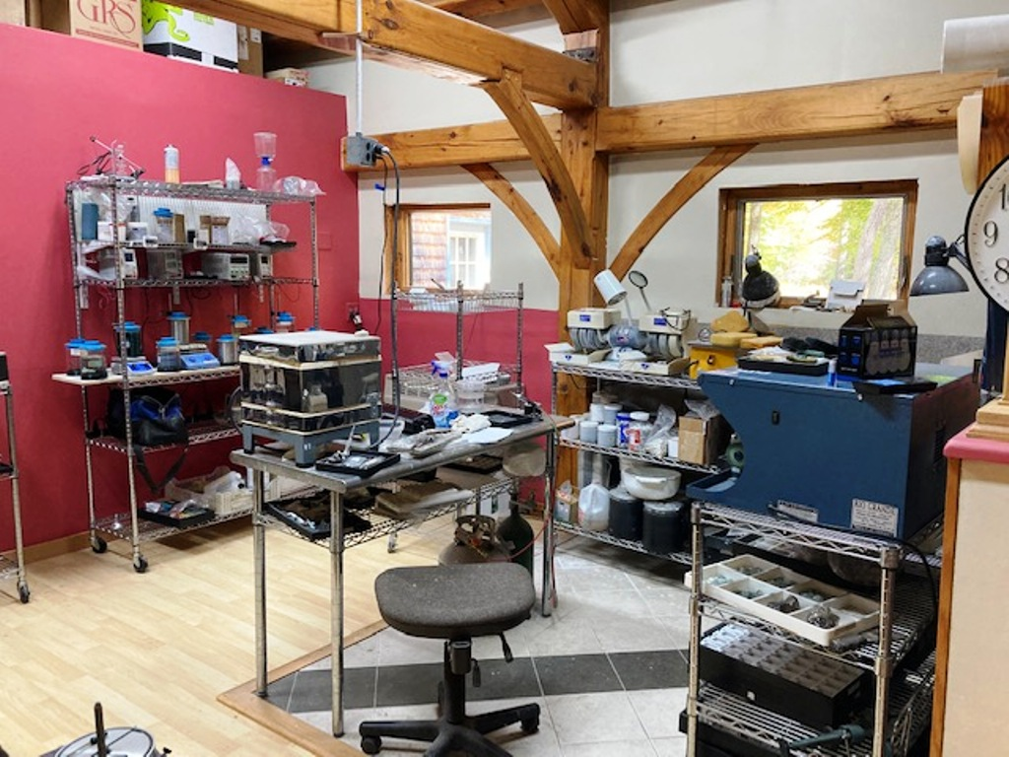
Home metal shop.
left side overall view

Slide 11
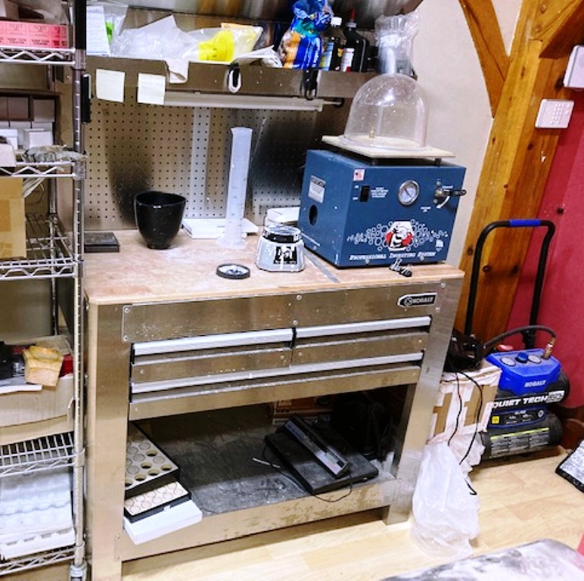
Investment Vacuum Machine
Investment mixing tools
Home metal shop.
The casting vessel is prepped here.
Mixing the investment and vacuuming out the air. The investment is poured into the vessel containing the model while on the vibrator plate. Again vacuum the air out of the vessel investment.
Air compressor for the GSR engraver
Vibrator plate

Slide 12
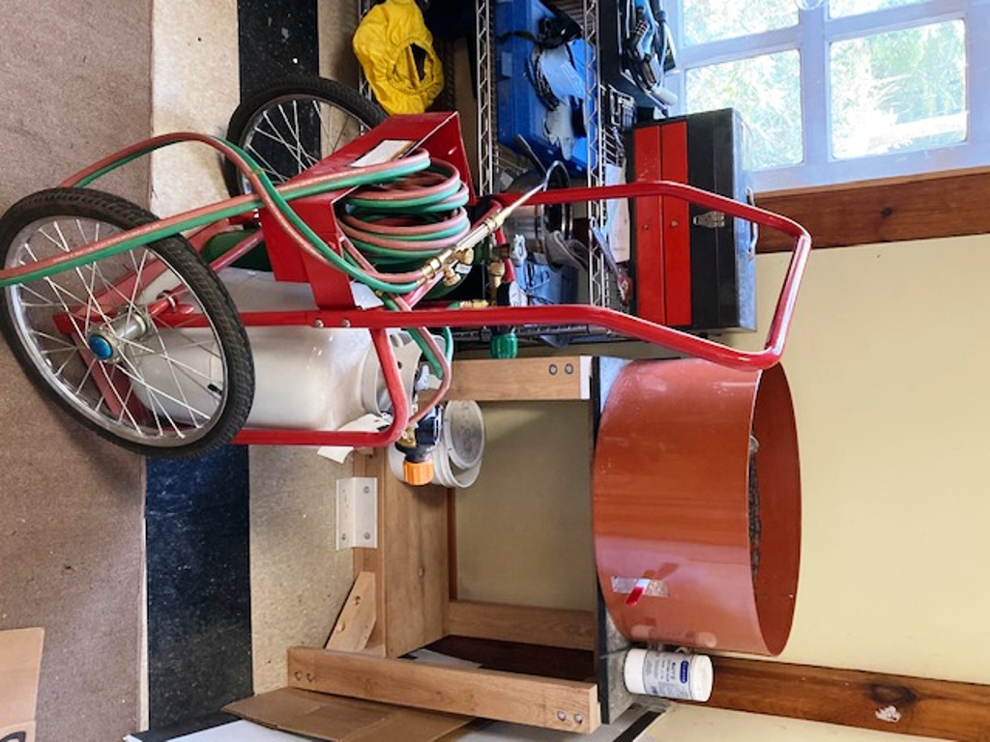
Spin Casting Machine
Gas tanks and torch
Home metal shop.
The casting is done here.

Slide 13
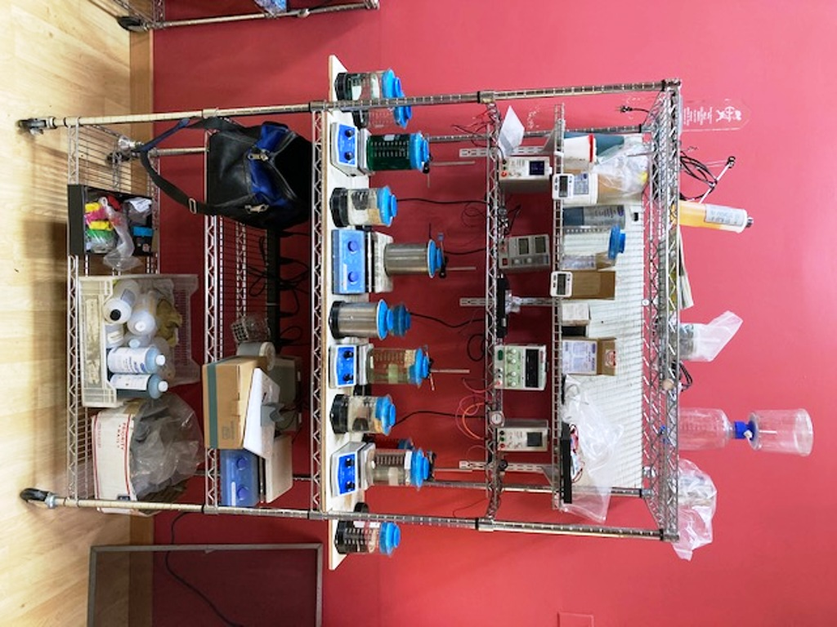
DC Rectifiers,
Each plating solution requires it’s own rectifier and power setting
Plating & cleaning solutions have there own heater a stirrer. Each solution has separate settings for temperature and time per item being plated
Home metal shop.
The Plating station.
This is were all the Rhodium &
Gold plating is performed.
All Toveco Silver Jewelry is Rhodium plated.

Slide 14
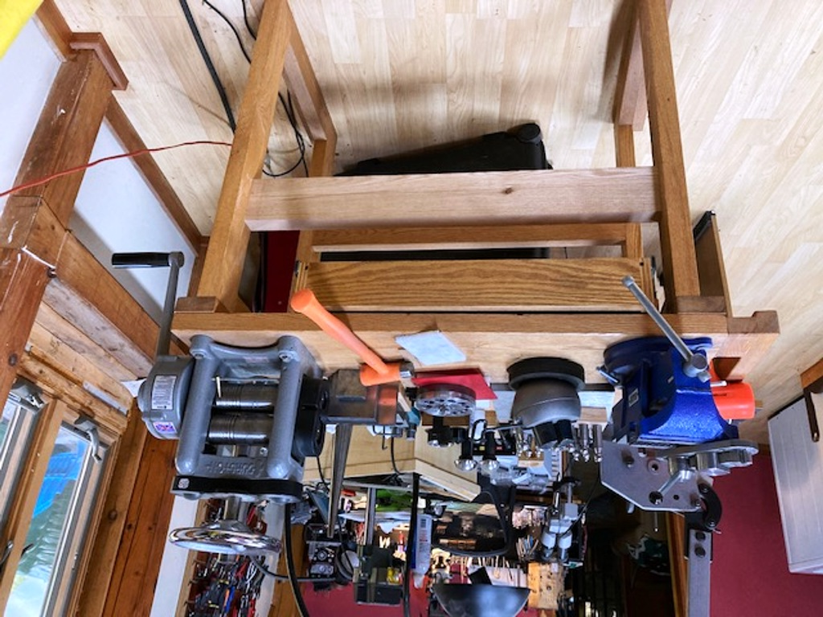
Metal cutter
Punches & forming dops
Ball Vice &
Forge Vice with ring bender
Rolling Mill
Home metal shop.
The Metal forming station.
This is were a lot of the metal forming is done.

Slide 15
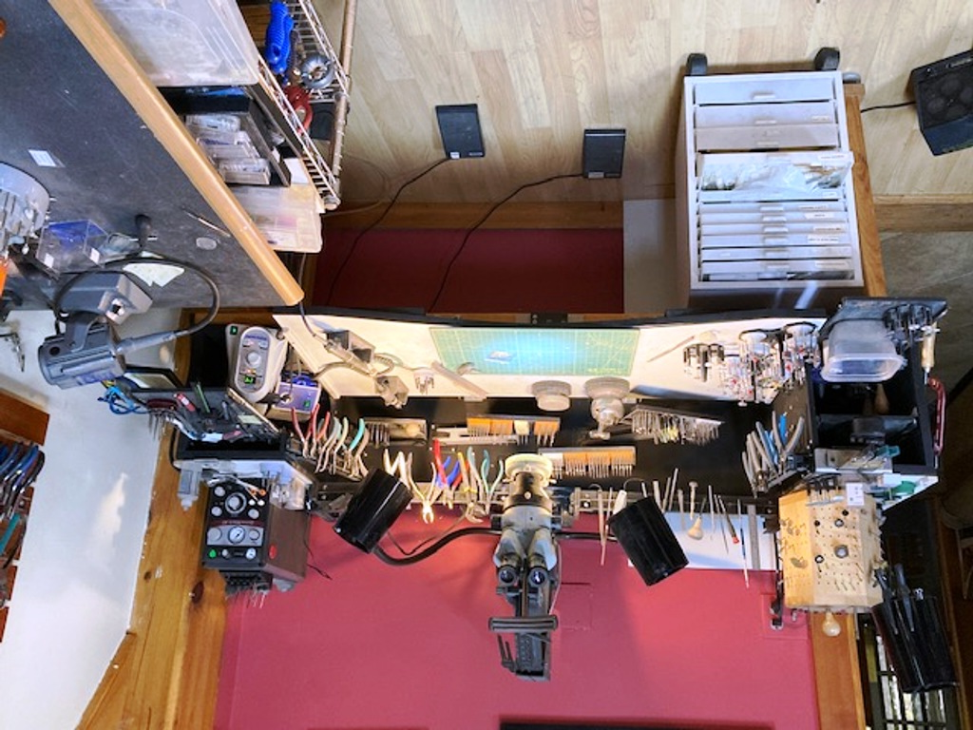
Tool holder
Microscope
GSR engraver
Foredom Micro Motors
Home metal shop.
The bench,this is where the fine metal work and gemstone setting is done. A lot of time is spent here.

Slide 16
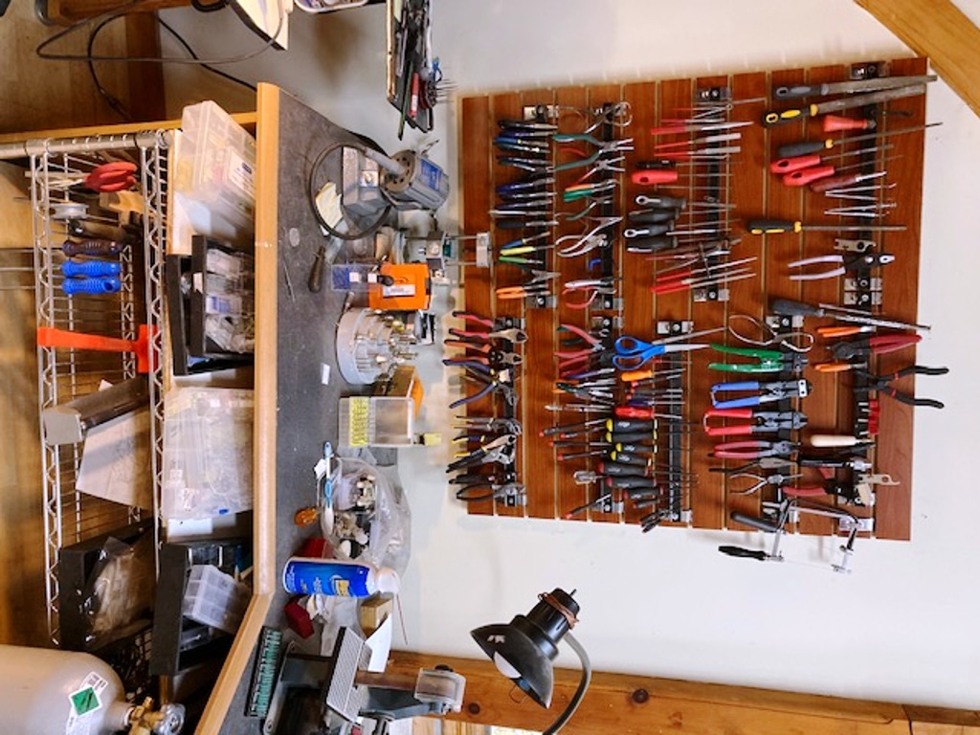
Hand tools,
Always adding new tools
Home metal shop.
The bench, Tool board.
You can never have enough tools.

Slide 17
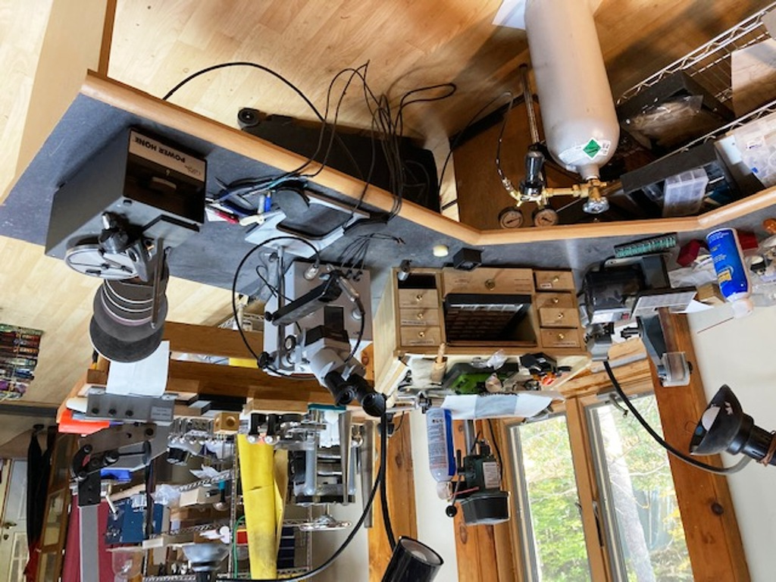
PUK micro arc-welder
GSR engraver
Shaping machine
Belt sander
Drill press
Home metal shop.
Back bench, This bench is right behind the main bench. I spend a lot of time using the PUK welder.

Slide 18
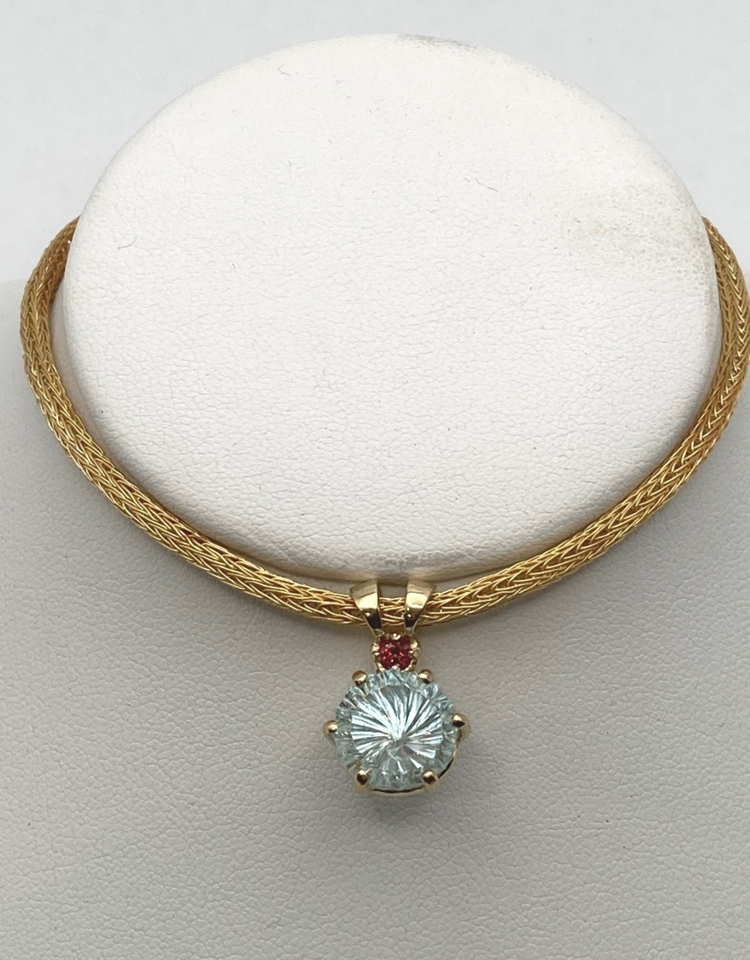
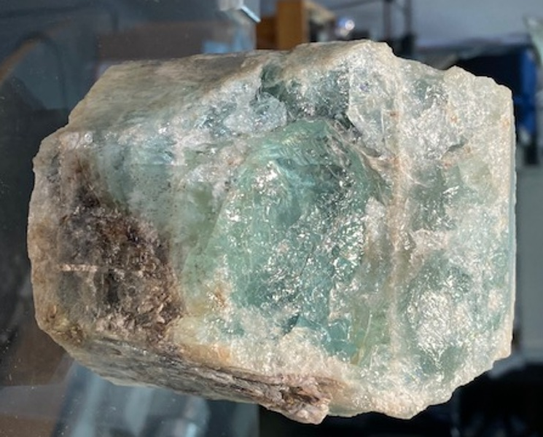
START TO FINISH JEWELRY
THE END

